Slide 1
Optimizing Warehouse Operations through In-House Information Systems
Md Abu Naeem khan Z1985093

Slide 2

Problem Description
Manual processes using paper logs and spreadsheets cause frequent errors like inventory mismatches, stockouts, and shipment mistakes.
Lack of real-time inventory tracking and outdated picking information leads to delays and inefficiencies in order fulfillment.
Absence of automation results in repeated operations, bottlenecks, increased human errors, and lower customer satisfaction.

Slide 3

Project Objectives and Scope
Objectives
Automate warehouse operations to minimize human errors and manual intervention.
Streamline order picking and dispatch processes to enhance operational efficiency.
Scope
Focus exclusively on core warehouse functions: product intake, inventory management, order fulfillment, and staff assignment.
Design and implement a relational database system in MS Access to manage warehouse operations.
Develop queries, forms, and reports to support real-time decision-making.
Excludes customer relationship management, procurement/supplier management, and financial transactions.

Slide 4
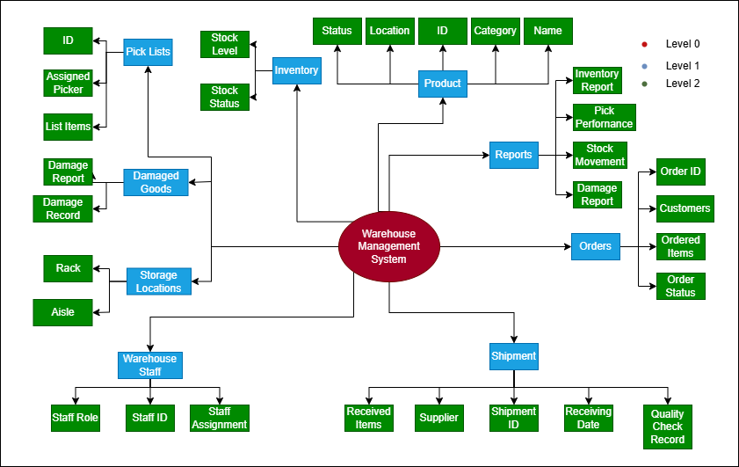
Systems Analysis: Concept Map

Slide 5

Systems Analysis: Needs/Requirements
How can we accurately track real-time inventory levels and prevent stockouts?
How can we automate order picking to reduce human errors?
How can we manage and monitor warehouse staff workloads efficiently?
How can we ensure that product, order, and inventory data remains consistent and accurate?
How can we generate useful reports to support better warehouse decision-making?

Slide 6
Systems Analysis: Gap Analysis
Aspect | Current Manual System | Proposed Database System | Gap
Inventory Tracking | Paper logs and spreadsheets; frequent stock mismatches and stockouts | Real-time inventory updates through centralized database; low stock alerts | Eliminates manual errors and stock visibility issues
Order Processing | Manual creation of pick lists; missing or outdated information | Automated pick list generation based on real-time inventory and pending orders | Reduces picking mistakes and speeds up order fulfillment
Staff Workload Management | No formal tracking of staff tasks or pick assignments | PickLists assigned to staff members; queries to monitor picker workload | Improves operational efficiency and workload balancing
Data Consistency and Integrity | High chance of duplicate entries and inconsistent records | Enforced referential integrity between tables (PK-FK relationships) | Ensures data accuracy and prevents record inconsistencies
Reporting and Decision Support | No structured reporting; manual compilation of reports | Automated Access queries and reports for low inventory, top products, pending orders | Enables faster, data-driven decision-making

Slide 7
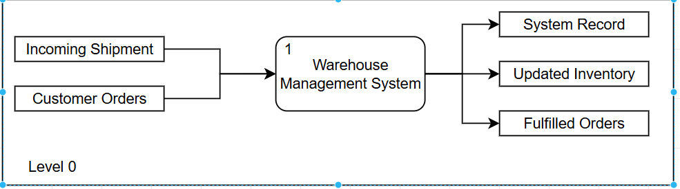
System Design: Data Flow Diagram(Level 0)
The Level 0 DFD represents the overall warehouse system as a single process: Manage Warehouse Operations.
It shows the external entities interacting with the system — Customers, Suppliers, and Warehouse Staff.
Key data flows include incoming shipments, product updates, customer orders, and reports.
This high-level diagram defines the system boundaries and primary inputs/outputs.

Slide 8
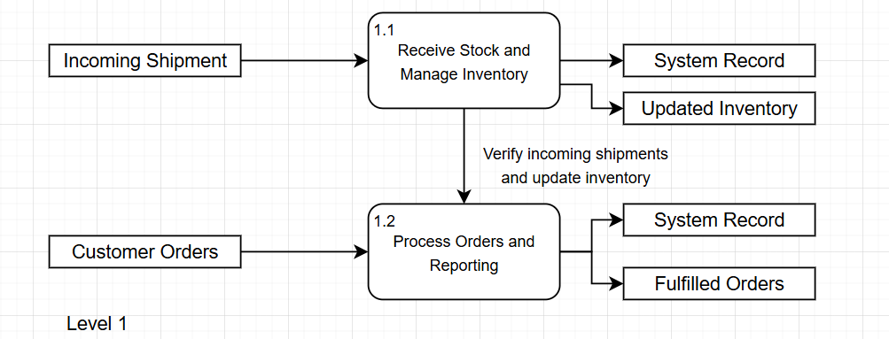
System Design: Level 1 DFD
The Level 1 DFD breaks down the main process into four core sub-processes.
It introduces major data stores such as Product, Inventory, and Order.
This diagram shows how data flows between internal processes and data stores.

Slide 9
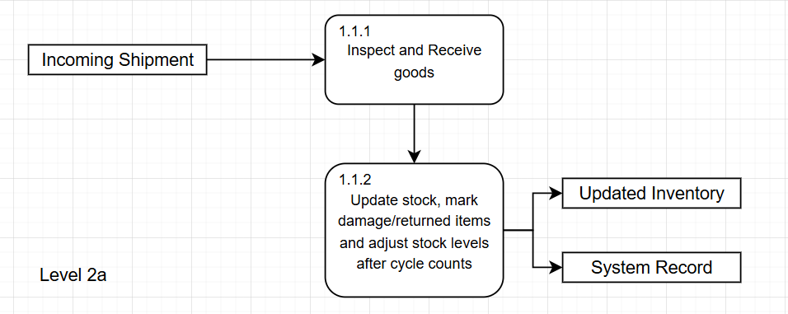
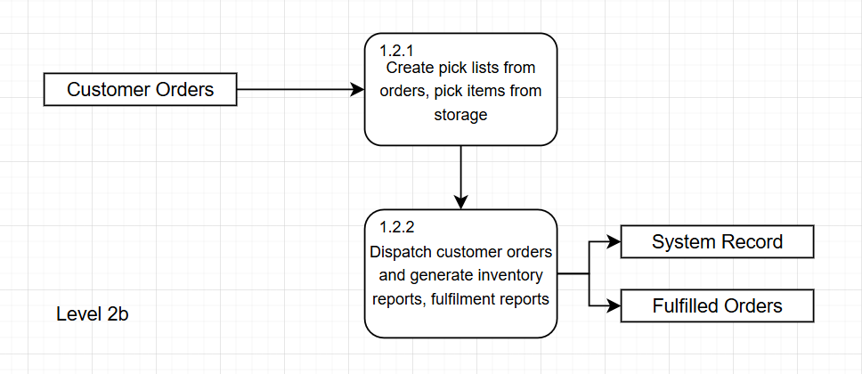
System Design: Level 2 DFD

Slide 10
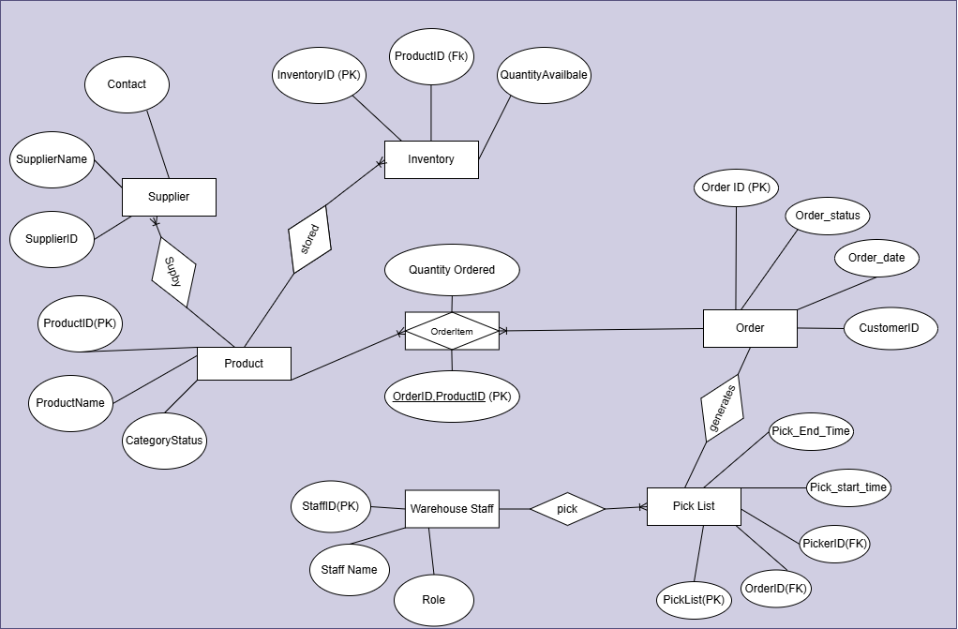
System Design: Initial ER Model

Slide 11
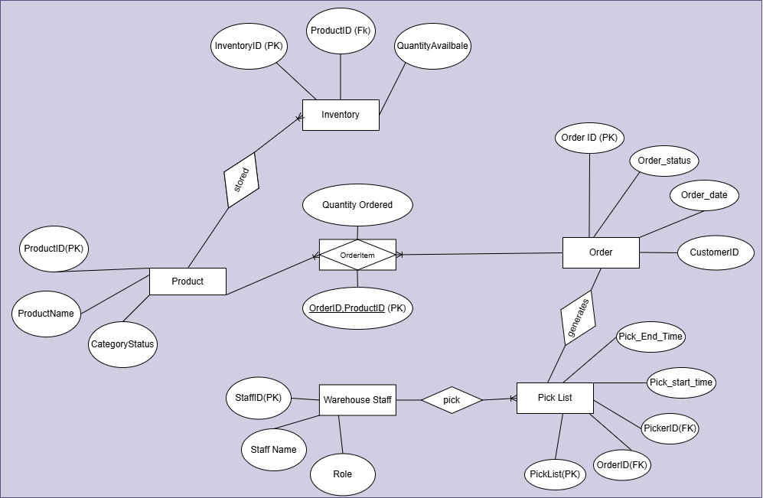
System Design: ER Model After Obligatory Analysis

Slide 12
System Design: Normalization
Entity | 1NF | 2NF | 3NF | 4NF
Product | Attributes are atomic | Product depends on full PK (ProductID) | No transitive dependency | No multivalued data
Inventory | Attributes are atomic | Full dependency on InventoryID | No transitive dependency | No multivalued data
Order | Attributes are atomic | Full dependency on OrderID | No transitive dependency | No multivalued data
OrderItem | Attributes are atomic | QuantityOrder depends on (OrderID, ProductID) together | No transitive dependency | No multivalued data
PickList | Attributes are atomic | Full dependency on PickListID | No transitive dependency | No multivalued data
WarehouseStaff | Attributes are atomic | Full dependency on StaffID | No transitive dependency | No multivalued data

Slide 13
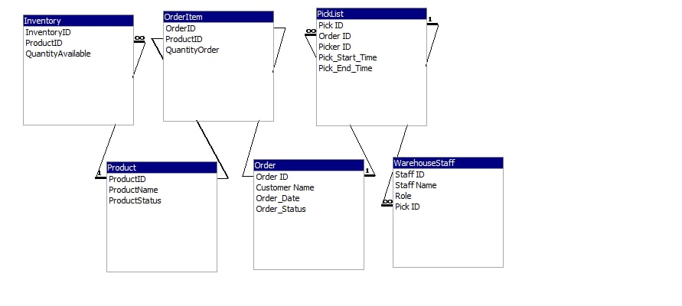
System Development: MS Access

Slide 14
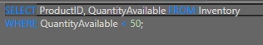
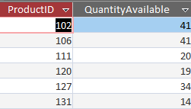
System Testing: Query
Which products currently have low inventory (less than 50 units)?

Slide 15
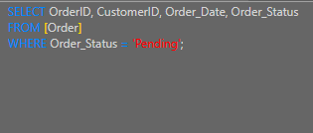
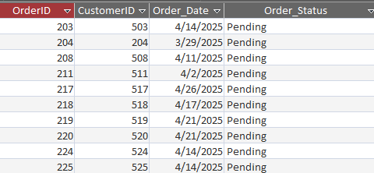
System Testing: Query
Which customer orders are still pending and need to be fulfilled?

Slide 16
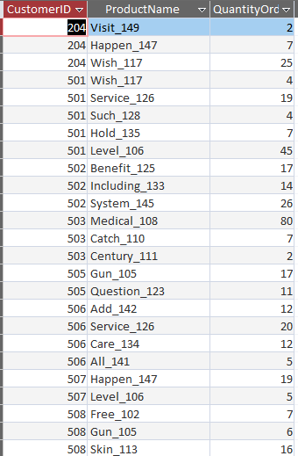
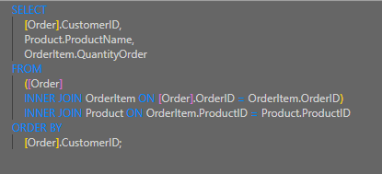
System Testing: Query
Which customers placed orders for which products, and how much quantity did they order?

Slide 17
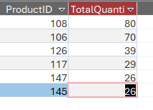
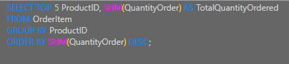
System Testing: Query
What are the top 5 products ordered the most (highest quantity ordered)?

Slide 18
Conclusion
Successfully transitioned a manual, error-prone warehouse operation into an organized, database-driven system.
Developed a relational database in MS Access, achieving full normalization up to 4NF for data integrity.
Designed and implemented efficient inventory tracking, order processing, staff management, and operational reporting.
Demonstrated real-time query capabilities to support faster deision-making and operational improvements.
Gained hands-on experience in database design, system analysis, entity-relationship modeling, and query development.

